Slide 1
Searching for the Neutron Electric Dipole Moment (EDM)
Why look for EDMs? Why the neutron?
How do you measure neutron EDM (nEDM)?
Overview of experiments to measure nEDM
Need lots of Ultra-Cold Neutrons (UCN)
Our new experiment at the Spallation Neutron Source at Oak Ridge National Lab
B. Filippone
Phys 242
1-12-2018

Slide 2
What is an EDM?
+e
l
d = e x l
-e
How big is the neutron EDM?
u-quark
+2/3e
if l ~ 0.1 r_{n}
-2(1/3e)
d_{n} ~ 4x10⁻¹⁴ e-cm
d-quarks
Experiment says d_{n} < 3x10⁻²⁶ e-cm

Slide 3
Why are EDMs Interesting?
Existence of EDM for neutron (or electron, proton) implies a violation of Time Reversal Invariance
This implies four distinguishable neutrons:
spin up, EDM up
spin down, EDM up spin up, EDM down
spin down, EDM down
Both states should exist if Time Reversal Symmetry is respected
But only two distinguishable neutron states exist!! (Pauli Principle)
→ Time Reversal Symmetry is violated

Slide 5
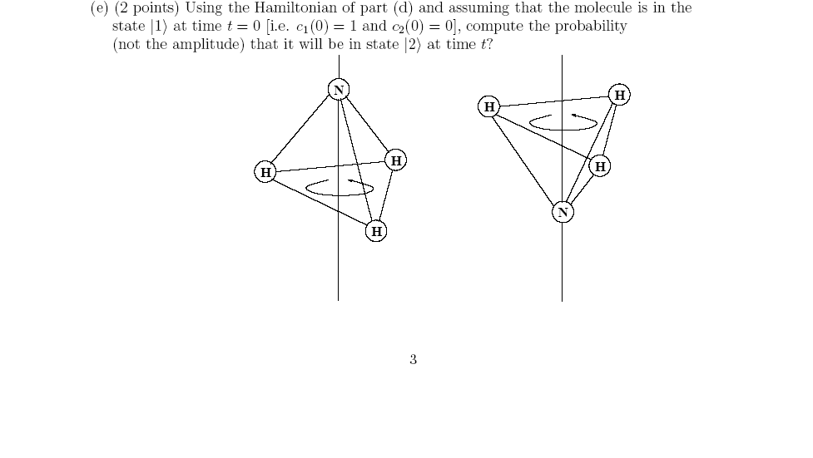









What about HUGE Molecular EDMs!
H₂0: d = 0.4 x 10⁻⁸ e-cm
NaCl: d= 1.8 x 10⁻⁸ e-cm
NH₃: d = 0.3 x 10⁻⁸ e-cm
$$\vec{\text{J}}$$
$$\vec{\text{J}}$$
But NH₃ EDM is not T-odd
or CP-odd since
$$\vec{\text{d}}$$
$$\vec{\text{J}}$$
$$\vec{\text{d}}$$
$$\vec{\text{d}}$$
$$\vec{\text{J}}$$
$$\vec{\text{J}}$$
$$\vec{\text{d}}$$
Ground state is actually a
superposition

Slide 6
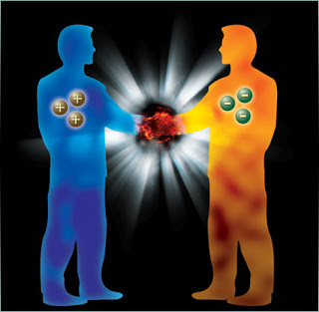
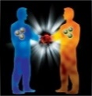
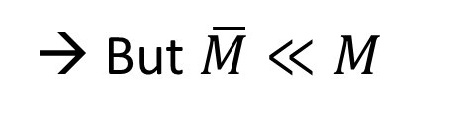
Why is CP Violation Interesting? → There’s a Big Puzzle in the Early Universe:
You might expect equal amounts of matter & antimatter in the Universe after the Big Bang
→ But $\overline{M}≪M$
http://www.iamatechie.com
Notes:
These symmetries are important when we discuss another problem with the Standard Model associated with matter production in the early universe.
Energy/photons can produce matter and antimatter – in equal amounts, but when we look around we don’t see anti-matter galaxies – via collisions.

Slide 7
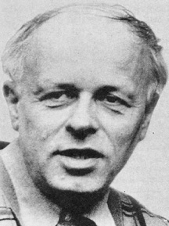
How to Make the Anti-Matter Disappear in the Early Universe?
http://scienceworld.wolfram.com
Sakharov Conditions (1967)
Total number of quarks must change
- Possible in Standard Model during the Big Bang
Departure from Thermal Equilibrium
- Phase Transitions can do this
CP & C violation
- Weak interaction violates C & CP
- But CP violation in the Standard Model is TOO small
A. Sakharov
Peace Nobel: 1975
New particles/interactions are needed to provide larger CP violation

Slide 8
Baryogenesis
Plausibility Argument
Consider heavy boson - X
Baryon number violation:
C-Violation & CP-Violation
Out of Thermal Equilibrium
Otherwise, in Equilibrium the reverse reactions:
(e.g. )
will smooth out any matter/antimatter excess

Slide 9
Electroweak Baryogenesis
Possible source of Matter-Antimatter Asymmetry
Before Electroweak Phase
Transition
After EW Phase
Transition
Today
Non-equilibrium
10¹⁰
N
0
γBB
γBB
γBB

Slide 10
Are there new sources of CP violation Beyond the Standard Model to account for matter/antimatter asymmetry?
Where to search for new sources of CP Violation?
Quarks/Gluons
Neutron/Proton EDM: Allows production of matter-antimatter asymmetry via “Baryogenesis”
Leptons (e, μ, τ, ν_{i})
Lepton EDMs
Neutrino mixing (2015 Nobel Prize - Art McDonald PhD from Caltech) suggests possibility of new CP violation in leptons
Allows production of matter-anti-matter asymmetry via “Leptogenesis”

Slide 11
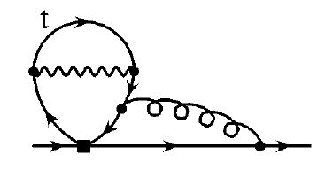
EDM Discovery Potential
Standard Model EDMs are due to CP violation in the quark weak mixing matrix (CKM), e.g. the K⁰/B⁰-system, but…
e⁻ and quark EDM’s are zero in 1st & 2nd order
Need at least three Feynman diagram “loops” to get EDM’s (electron actually requires 4 loops!)
Thus EDM’s are VERY small in standard model
Neutron EDM in Standard Model is
~ 10⁻³¹ e-cm (=10⁻¹⁸ e-fm)
g
W
d,s,b
Experimental neutron limit: < 3 x 10⁻²⁶ e-cm
Room for discovery = 5 orders of magnitude

Slide 12
CKM Matrix
Links weak flavor changing processes among quarks
(e.g. d → u + W, or c → s)
δ is the CP violating phase

Slide 13
Neutron EDM & New Physics
Small EDM in standard model provides negligible “background” signal
New CP violation “natural” in new physics
e.g. d_{n} ~ 10⁻²⁵ e-cm x sinϕ_{CP}(1 TeV/M_{BSM})²

Slide 14
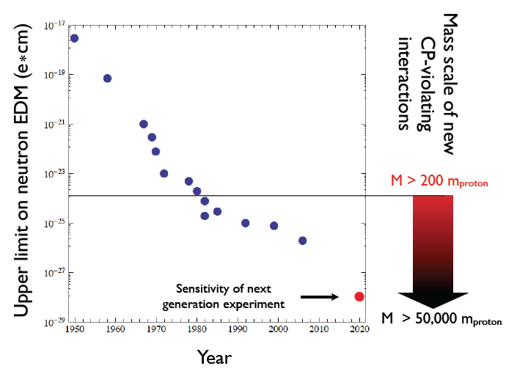
Impact of non-zero EDM
Amin Aboubrahim, Tarek Ibrahim, Pran Nath, The Neutron Electric Dipole Moment and Probe of PeV Scale Physics, Phys. Rev. D , 91, 095017 (2015).
Must be new Physics
Sharply constrains
models beyond the
Standard Model
(especially with
LHC data)
May account for matter-antimatter asymmetry of the universe

Slide 15
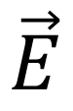
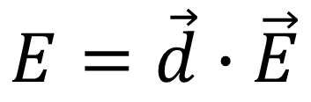
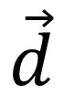
Similar Physics at Enormously Different Energy Scales
Neutron Electric Dipole Moment
+
-
$$\vec{d}$$
$$\vec{E}$$
“Next LHC” Collision Energy
LHC Collision Energy
Proton Rest Mass Energy
Neutron Beta Decay Energy
Neutrino Rest Mass Energy
$$E=\vec{d}∙\vec{E}$$
10¹⁴ eV
10¹³ eV
10⁹ eV
10⁶ eV
10⁻¹ eV
10⁻²³ eV
Higgs Boson
Notes:
We now step down to very low energies. This is the energy of the neutron’s electric dipole moment in an electric field at the future sensitivity. No EDM has yet been observed in neutron, proton, quark, muon, electron, tau …

Slide 16
Where should we look for EDMs?
Neutral systems are easiest
charged particles are accelerated in E-field
Weak Particles: Leptons (e.g. electrons & muons)
Electrons in atoms/molecules, muons in storage rings
Strongly Interacting Particles: Hadrons (e.g. p, n)
Free neutrons, atoms with paired electrons (e.g. diamagnetic), protons in storage rings

Slide 18
Simplified Measurement of EDM
E-field
1. Inject polarized particle
2. Rotate spin by π/2
3. Flip E-field direction
4. Measure frequency shift
B-field
Must know B very well

Slide 20
Experimental EDMs
Present best limits come from atomic systems and the free neutron
Paramagnetic atoms like ²⁰⁵Tl & polar molecules (ThO) are primarily sensitive to electron EDM
Diamagnetic atoms (e.g. ¹⁹⁹Hg) and the free neutron are primarily sensitive to
Future best limits may come from
Molecular Ions (HfF-, ThF-)
Liquids (¹²⁹Xe)
Solid State systems (high density)
Storage Rings (Muons, Deuterons, Protons)
Radioactive Atoms (²²⁵Ra, ²²³Rn)
New Technology for Free Neutrons (PSI, ILL, SNS)

Slide 21
Why so many EDM searches? They remain highly motivated
Particle Physics Project Prioritization Panel
“ Among the most powerful probes of new physics that does not conserve CP are the electric dipole moments (EDM’s) of the neutron, electron and proton … sensitive to contributions from new particle masses at the 10-100 TeV scale. A new direct neutron edm experiment is planned at Oak Ridge National Laboratory. “

Slide 22
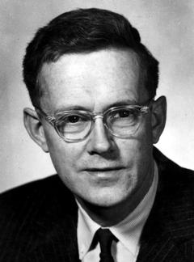
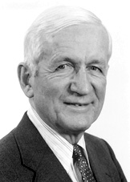
Searches for a Neutron EDM
E.M. Purcell and N.F. Ramsey, Phys. Rev. 78, 807 (1950)
Searching for Parity Violation in Neutron Scattering
Pioneered Neutron Beam Magnetic Resonance
i.e. nuclear magnetic resonance (NMR)
Leading to magnetic resonance imaging (MRI)

Slide 23
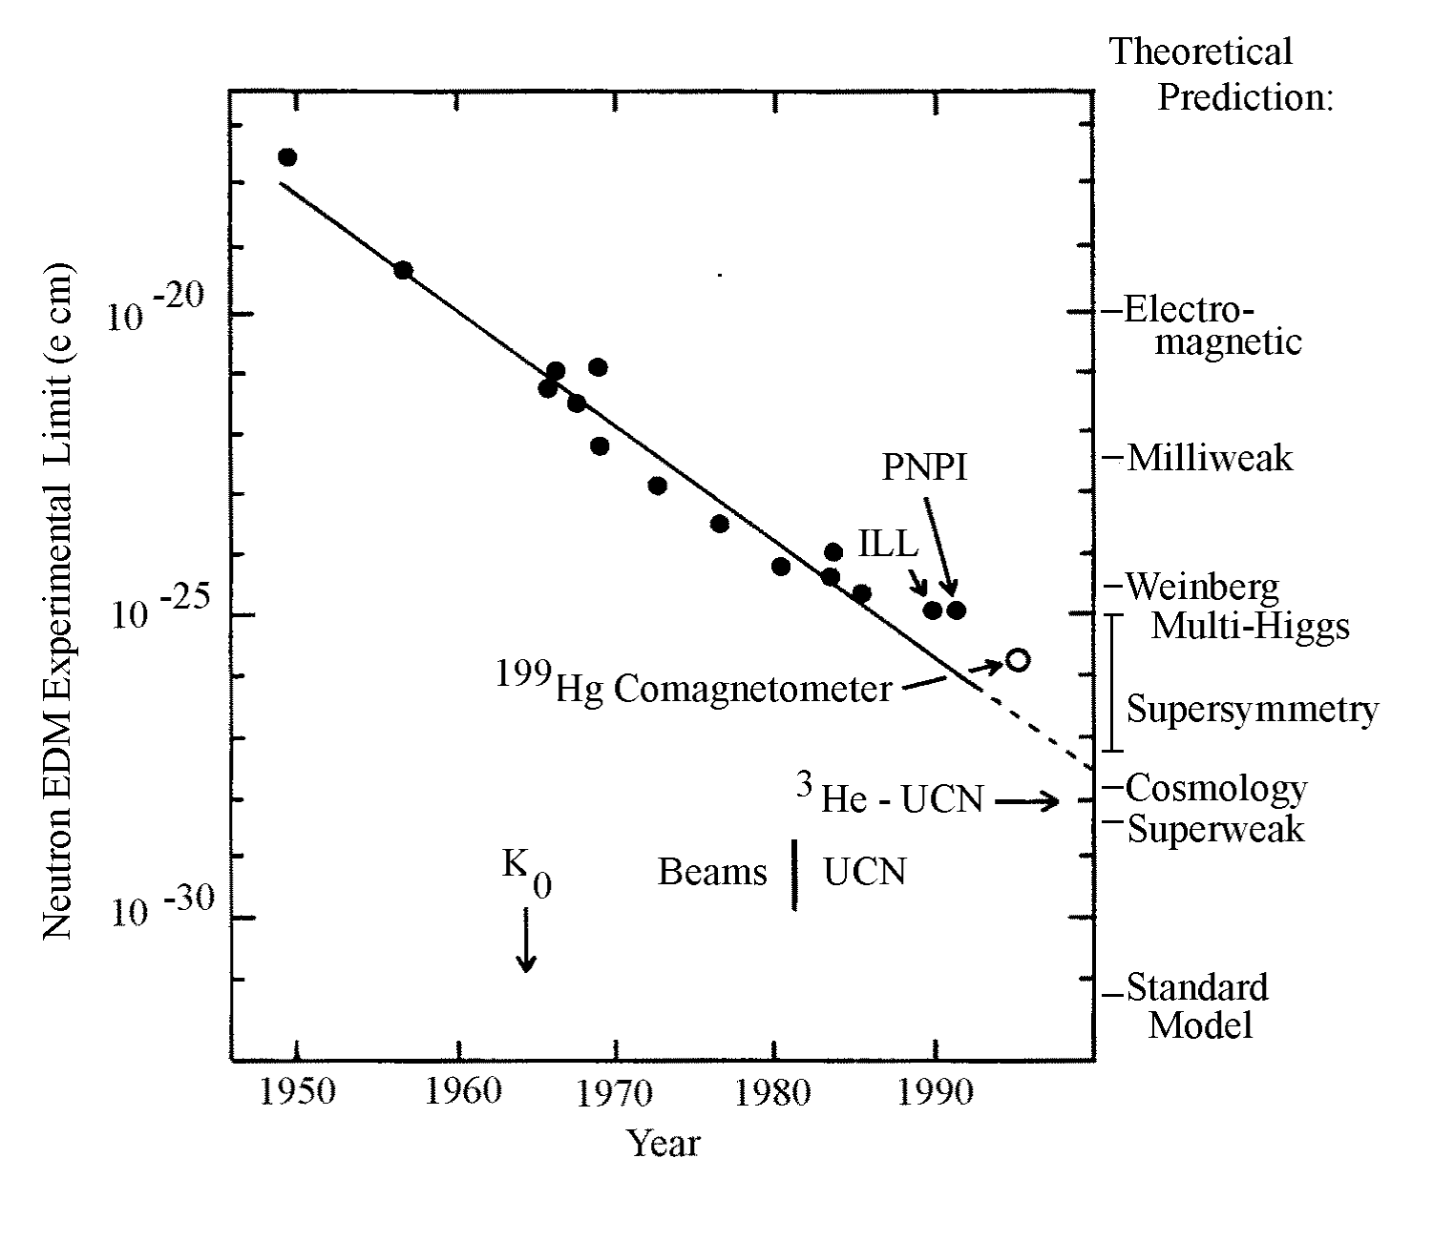
n-EDM vs Time

Slide 24
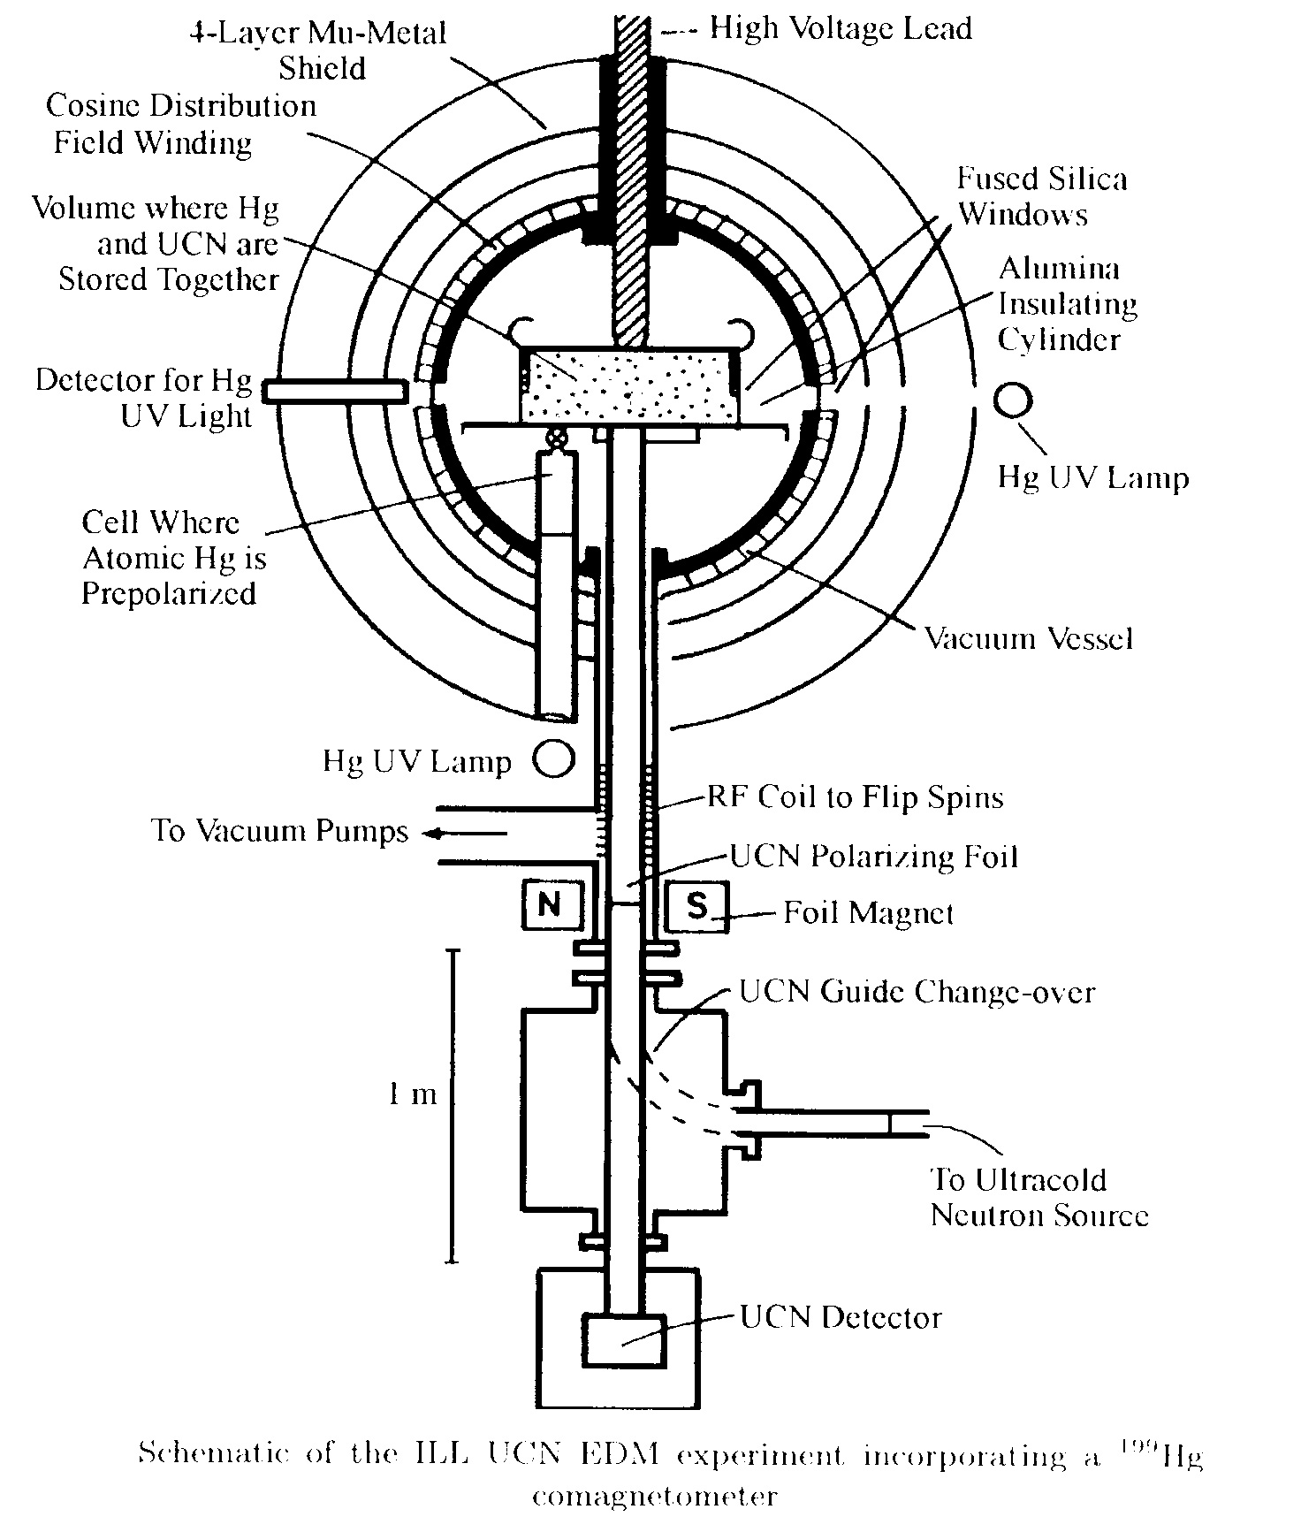
Best Neutron Limit: ILL-Grenoble neutron EDM Experiment
Harris et al. Phys. Rev. Lett. 82, 904 (1999)
Baker et al. Phys. Rev. Lett. 97, 131801 (2006)
Trapped Ultra-Cold
Neutrons (UCN) with
N_{UCN} = 0.5 UCN/cc
|E| = 5 - 10 kV/cm
100 sec storage time
σ_{d} = 3 x 10⁻²⁶ e cm

Slide 25
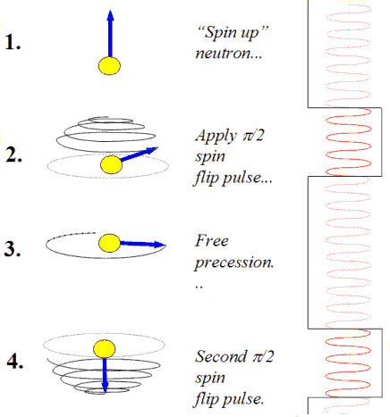
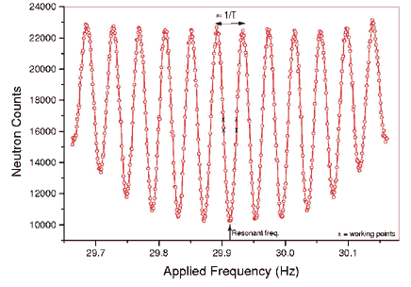
How to measure frequency precisely:
ILL uses Ramsey separated-oscillatory field technique
Inject n h
Rotate by π/2 and precess for Δt
Spin rotates by ωΔt ( >>1 radian)
Rotate back by π/2
Measure how many
nh vs. ni
What are these Ultra-Cold Neutrons?

Slide 26
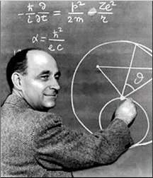
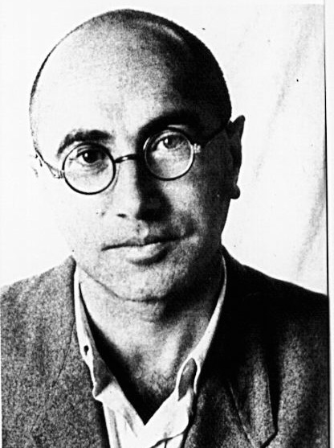
Ultra-Cold Neutrons (UCN) (Fermi/Zeldovich)
What are UCN ?
Very slow neutrons
(v < 8 m/s , λ > 500 Å )
that cannot penetrate into
certain materials
Neutrons can be
trapped in bottles
or by magnetic
field

Slide 27
But… nuclear force is attractive at low
energies.
Where does repulsion come from?
Recall (for short-range potential):
At low energies (kr₀<<1; eg s-wave) elastic scattering determined solely by scattering length a
For k 0
σ_{elas} = 4πa²

Slide 28
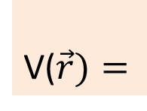
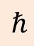
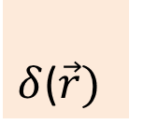
Scattering Length
Repulsive Potential
Weak Attractive Potential
Strong Attractive Potential
Same !
Thus many different V₀ and r₀ can give same a
→ Fermi
V($\vec{r})=$
$$ℏ$$
$δ$($\vec{r})$

Slide 29
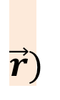
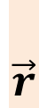
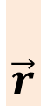
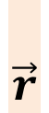
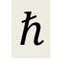
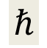
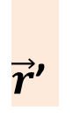
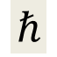


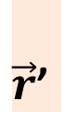
Fermi Pseudopotential
$$\vec{r})$$
$$\vec{r}$$
$\vec{r}$’
$$ℏ$$
Then for many nuclei in a solid:
$$\vec{r}$$
$$\vec{r}$$
$\vec{r}$’
And if a_{i} = a and
λ >> atomic spacing:
$$ℏ$$
$$\vec{r}$$
$$\vec{r}$$
$$ℏ$$
n₀ is the number density
Effective Step Potential

Slide 30
Effective Potential Step
E_{UCN}
The coherent nuclear potential can lead to repulsive pseudopotential for a > 0
For E_{UCN} < V₀, UCN are trapped
Attractive potential can also lead to neutron absorption
but often L_{mfp} >> λ_{n} (~10⁻⁵ probability per bounce)

Slide 31
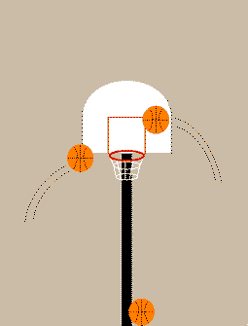
UCN Properties
g
3m
UCN

Slide 32
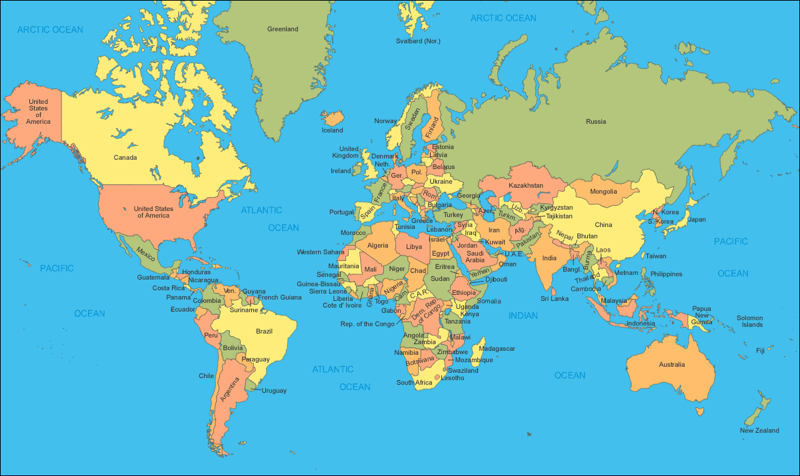
Worldwide neutron EDM Searches
PNPI
TRIUMF
ILL
FRMII
PSI
J-PARC
LANL
SNS
RCNP

Slide 33
Neutron EDM Searches
Experiment | UCN source | cell | Measurement techniques | σ_{d} Goal (10⁻²⁸ e-cm)
ILL - CryoEDM | Superfluid ⁴He | ⁴He | Cryo HV, SuperCond., Ramsey technique, external SQUID mag. | < 5
ILL-PNPI | ILL turbine PNPI/Solid D₂ | Vac. | Ramsey technique for ω E=0 cell for magnetometer | Phase1<100 < 10
ILL Crystal | Cold n Beam | solid | Crystal Diffraction Non-Centrosymmetric crystal | < 100
PSI EDM | Solid D₂ | Vac. | Ramsey for ω, external Cs & Hg comag. Xe or Hg comagnetometer | Phase1 ~ 100 Phase 2 < 20
Munich FRMII/ILL | Solid D₂ | Vac. | Room Temp. , Hg Co-mag., also external 3He & Cs mag. | < 5
RCNP/TRIUMF | Superfluid ⁴He | Vac. | Small vol., Xe co-mag. @ RCNP Then move to TRIUMF | < 100 < 20
SNS nEDM | Superfluid ⁴He | ⁴He | Cryo-HV, ³He capture for ω, ³He co-mag. with SQUIDS & dressed spins, supercond. | < 5
JPARC | Solid D₂ | Vac. | Under Development | < 5
JPARC | Solid D₂ | Solid | Crystal Diffraction Non-Centrosymmetric crystal | < 100
LANL | Solid D₂ | Vac. | R & D, Ramsey SOF, Hg co-mag. | < 50
Present neutron EDM limit < 300
= sensitivity < 5 x 10⁻²⁸ e-cm

Slide 34
To further improve search for neutron EDM, need new techniques
Enhance number of stored neutrons
Increase Electric field
Minimize key systematic effects

Slide 35
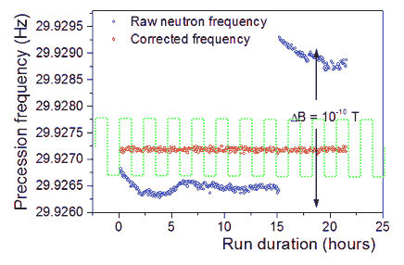
Systematic Effects in nEDM
Variation of B-field
Co-magnetometer cancels B-field variations
¹⁹⁹Hg Magnetometer

Slide 36
Systematic Effects in nEDM
Variation of B-field
Co-magnetometer cancels B-field variations
Leakage currents from Electric Field
These may produce B-fields/heating that changes with
E-field (must be less than nA/10pA)
v x E effects are the largest sources of systematic error in previous ILL exp.
B_{E} = v x E g changes precession frequency
Adds geometric phase when combined with B gradients

Slide 37
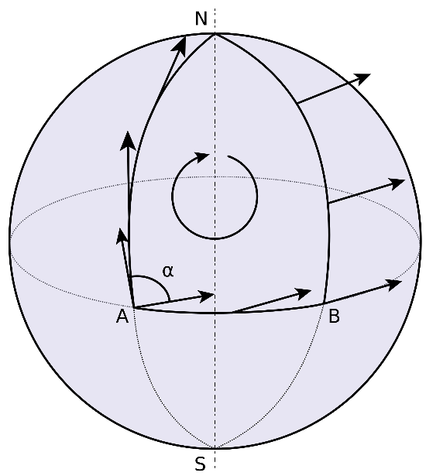
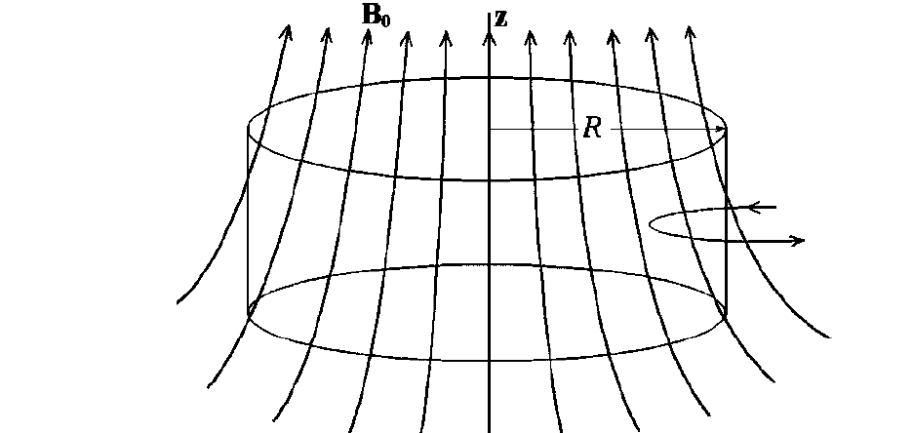
“Geometric Phase” Systematic Effect
For slow particles:
Path-dependent phase
E.g. Parallel transport of vector on sphere
In Quantum Mechanics often called Berry’s phase
Actually a relativistic effect for neutrons!
Motional (vxE) B-fields can add to radial B fields perpendicular to B₀ (These result e.g. from dB₀/dz) giving a false EDM

Slide 38
New Technique for n-EDM
E-field
Inject polarized neutron
& polarized ³He
2. Rotate both spins by 90º
3. Measure n+³He capture
vs. time
(note: σ_{ih}>>σ_{hh})
n + ³He → p + ³H
4. Flip E-field direction
B-field
³He functions as “co-magnetometer”
³He EDM shielded by atomic electrons

Slide 39
Example of future Neutron EDM Sensitivity
 | EDM @ ILL | EDM @ SNS
N_{UCN} | 1.3 x 10⁴ | 4 x 10⁵
|E| | 10 kV/cm | 70 kV/cm
T_{m} | 130 s | 1000 s
m (cycles/day) | 270 | 25
σ_{d} (e-cm)/day | 3 x 10⁻²⁵ | 3.5 x 10⁻²⁷
Improve
Sens.
x 5.5
x 7
x 2.3
x 90

Slide 40
Two Independent Measurements of Neutron Frequency
Capability for using two EDM measurement techniques is built into the apparatus
Oscillation of scintillation rate during free precession
Spin Dressing
seeks to make the “effective” magnetic moments equal to minimize sensitivity to background fields
2 techniques provide critical cross-check of EDM
result with different systematics and risks
Statistical sensitivity < 4 x 10⁻²⁸ e-cm

Slide 41
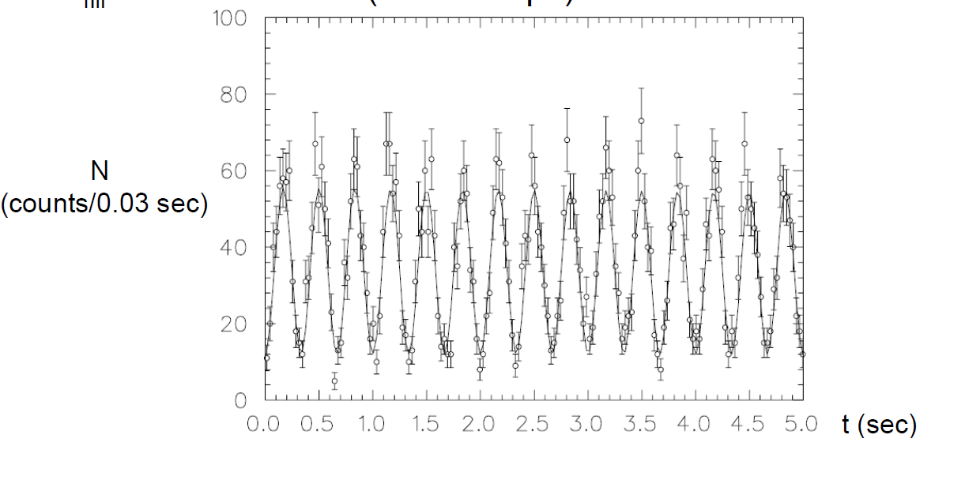
1-Direct measurement of frequency e.g. via spin-dependent neutron capture on polarized ³He capture count rate (measured by LHe scintillation) oscillates at n-³He beat frequency

Slide 42
2-“Dressed” Spins
By applying a strong non-resonant AC field, the effective precession frequencies can be modified or “dressed”
For particular values of the dressing field, the neutron and ³He precession frequencies in a plane can be made equal

Slide 43
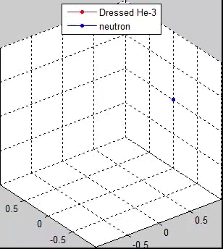
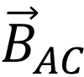
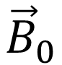
Dressed Spin Movie
Geometry of B-Fields
$${\vec{B}}_{0}$$
$${\vec{B}}_{AC}$$
Can match effective precession
frequency about B₀ of n ³He

Slide 44
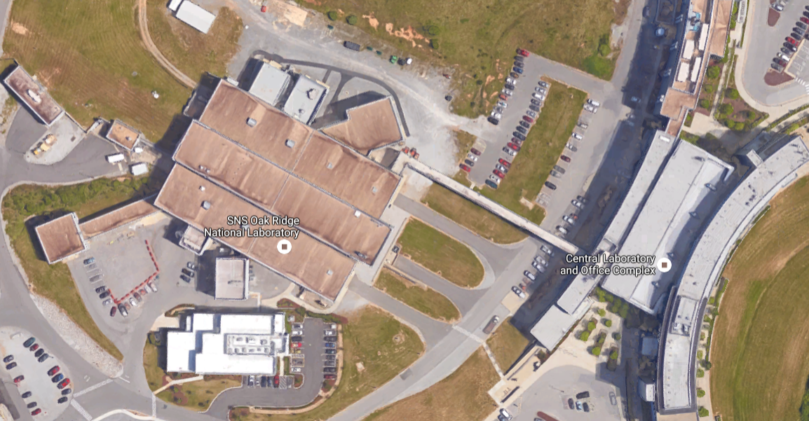

nEDM Experiment at SNS (nEDM@SNS)
Concept:
R. Golub & S. K. Lamoreaux, Phys. Rep. 237, 1 (1994)
High density of trapped neutrons – Cold neutrons from SNS cooled to “Ultra-cold”
neutrons via phonon scattering in superfluid He
Liquid Helium as a high voltage insulator – high electric fields
Use of a ³He co-magnetometer and superconducting shield – Control and measure magnetic field systematics
Precession frequency measurement via two techniques:
free precession
“dressed spin” techniques
Sensitivity reach: dn ~ 2 x 10^{–28} e-cm (in 3 calendar yrs)
“Most ambitious nEDM experiment that is currently underway”

Slide 45
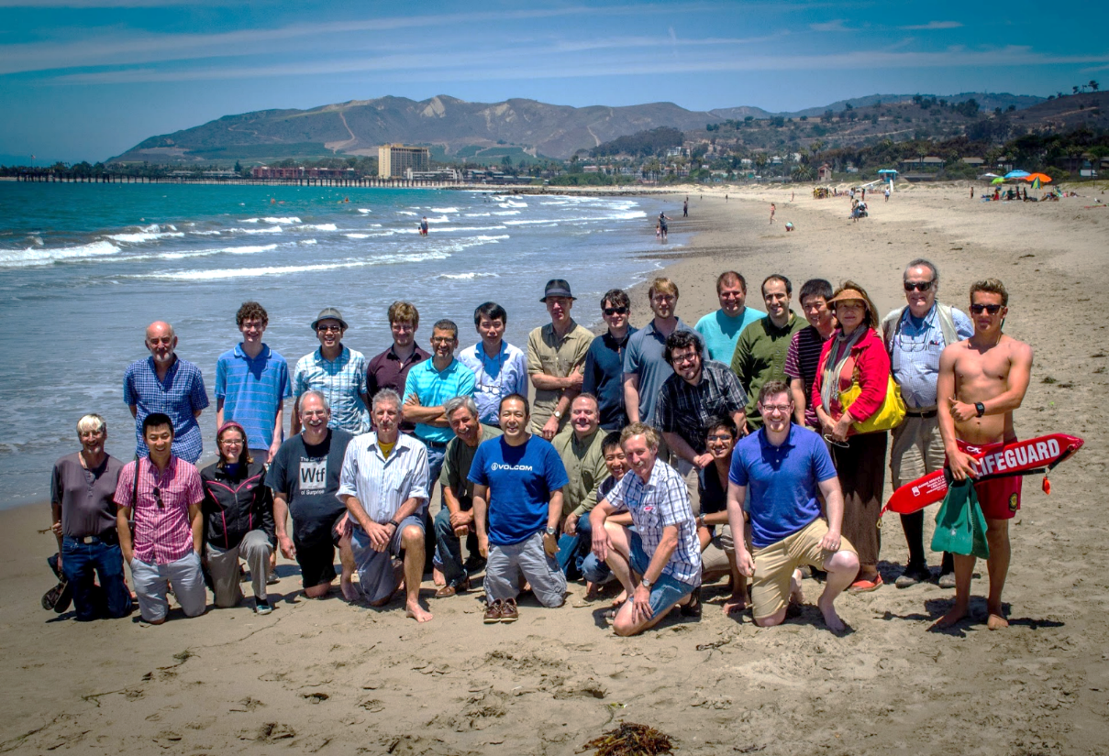
M. Karcz, C.-Y. Liu, J. Long, H.O. Meyer, M. Snow
Indiana University
L. Bartoszek, D. Beck, C. Daurer, J.-C. Peng, T. Rao, S. Williamson, L. Yang
University of Illinois Urbana-Champaign
C. Crawford, T. Gorringe, W. Korsch, E. Martin, N. Nouri, B. Plaster
University of Kentucky
S. Clayton, S. Currie, T. Ito, Y, Kim, M. Makela, J. Ramsey, W.Sondheim. Z, Tang, W. Wei
Los Alamos National Lab
K. Dow, D. Hasell, E. Ihloff, J. Kelsey, J. Maxwell, R. Milner, R. Redwine, E. Tsentalovich, C. Vidal
Massachusetts Institute of Technology
D. Dutta, E. Leggett
Mississippi State University
R. Golub, C. Gould, D. Haase, A. Hawari, P. Huffman, E. Korobkina, K. Leung, A. Reid, A. Young
North Carolina State University
R. Allen, V. Cianciolo, Y. Efremenko, P. Mueller, S. Penttila, W. Yao
Oak Ridge National Lab
M. Hayden
Simon Fraser University
G. Greene, N. Fomin
University of Tennessee
S. Stanislaus
Valparaiso University
S. Baeβler
University of Virginia
S. Lamoreaux
Yale University
nEDM Collaboration, Ventura Beach, CA
R. Alarcon, R. Dipert
Arizona State University
G. Seidel
Brown University
D. Budker
UC Berkeley
M. Blatnik, R. Carr, B. Filippone, C. Osthelder, S. Slutsky, X. Sun, C. Swank
California Institute of Technology
M. Ahmed, M. Busch, P. –H. Chu, H. Gao
Duke University
I. Silvera
Harvard University
Project Manager: V. Cianciolo
Spokesperson: BWF
Notes:
~ 80 physicists, 19 institutions,

Slide 46
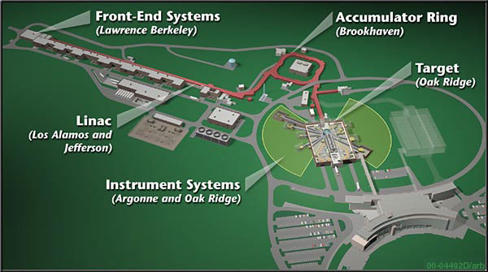
Spallation Neutron Source (SNS) at ORNL
1 GeV proton beam with 1.4 MW on spallation target

Slide 47
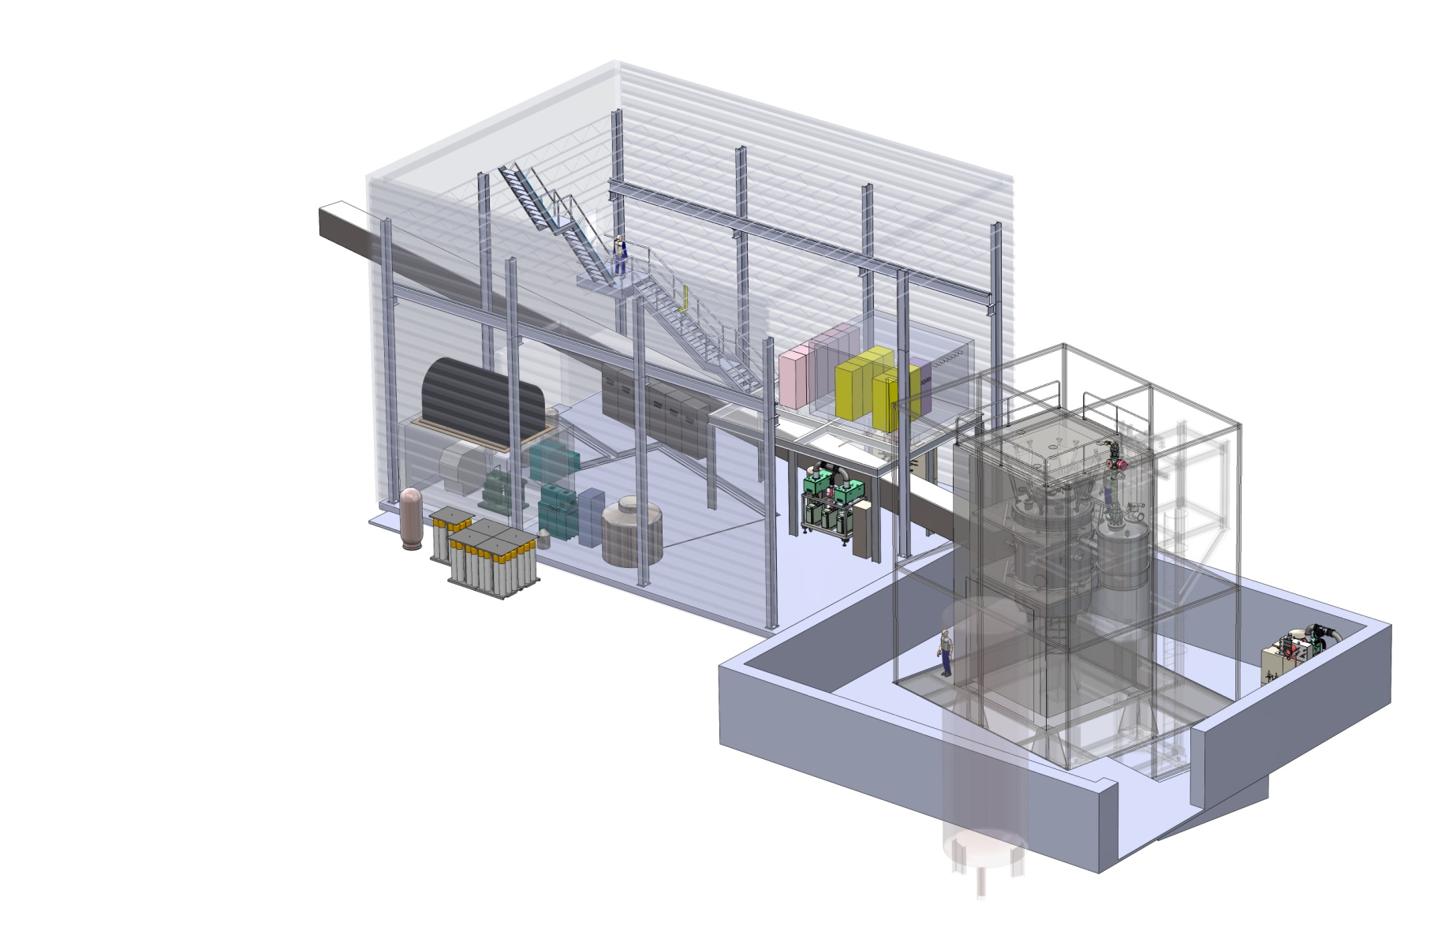
nEDM in new building

Slide 48
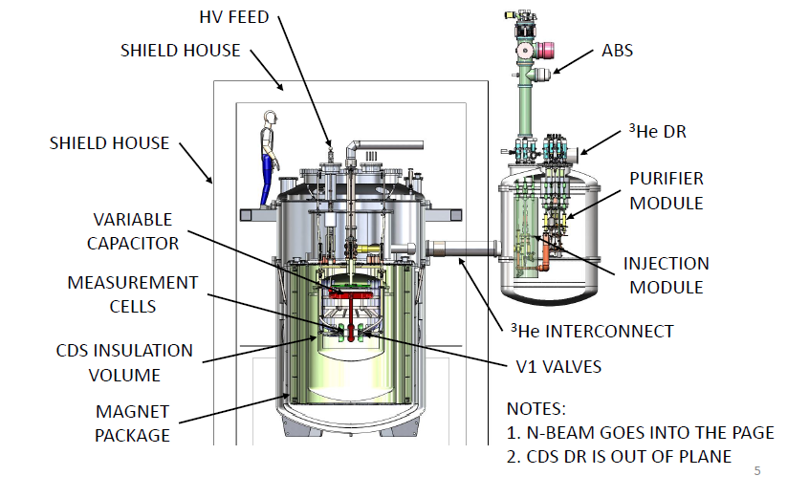
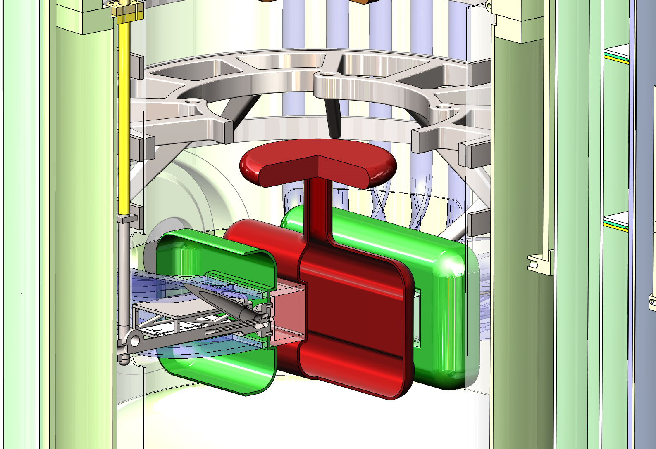
Components of the Experiment
3He ATOMIC BEAM SOURCE
MAGNETIC SHIELD HOUSE
3He DILUTION REFRIGERATOR
CENTRAL DETECTOR SYSTEM

Slide 49
Technical Challenges for nEDM@SNS
1200 L of superfluid Helium @ T = 0.5K
Must minimize heat sources
Eddy-current heating from AC B-fields → minimal conducting material
Large cooling plant required
High electric fields: E = 75 kV/cm
Producing and maintaining V > 600 kV in cryogenic environment
Highly sensitive to magnetic field variations and gradients
Significant magnetic shielding required
B-field uniformity of ppm/cm over measurement volume
Low-field operation: B = 3 μT

Slide 50
nEDM at Caltech
Scientific leadership of the Experiment
Spokesperson is from Caltech
Responsible for Magnets and Magnetic Shielding for experiment
Responsible for detailed studies of the ultimate sensitivity of the experiment

Slide 51
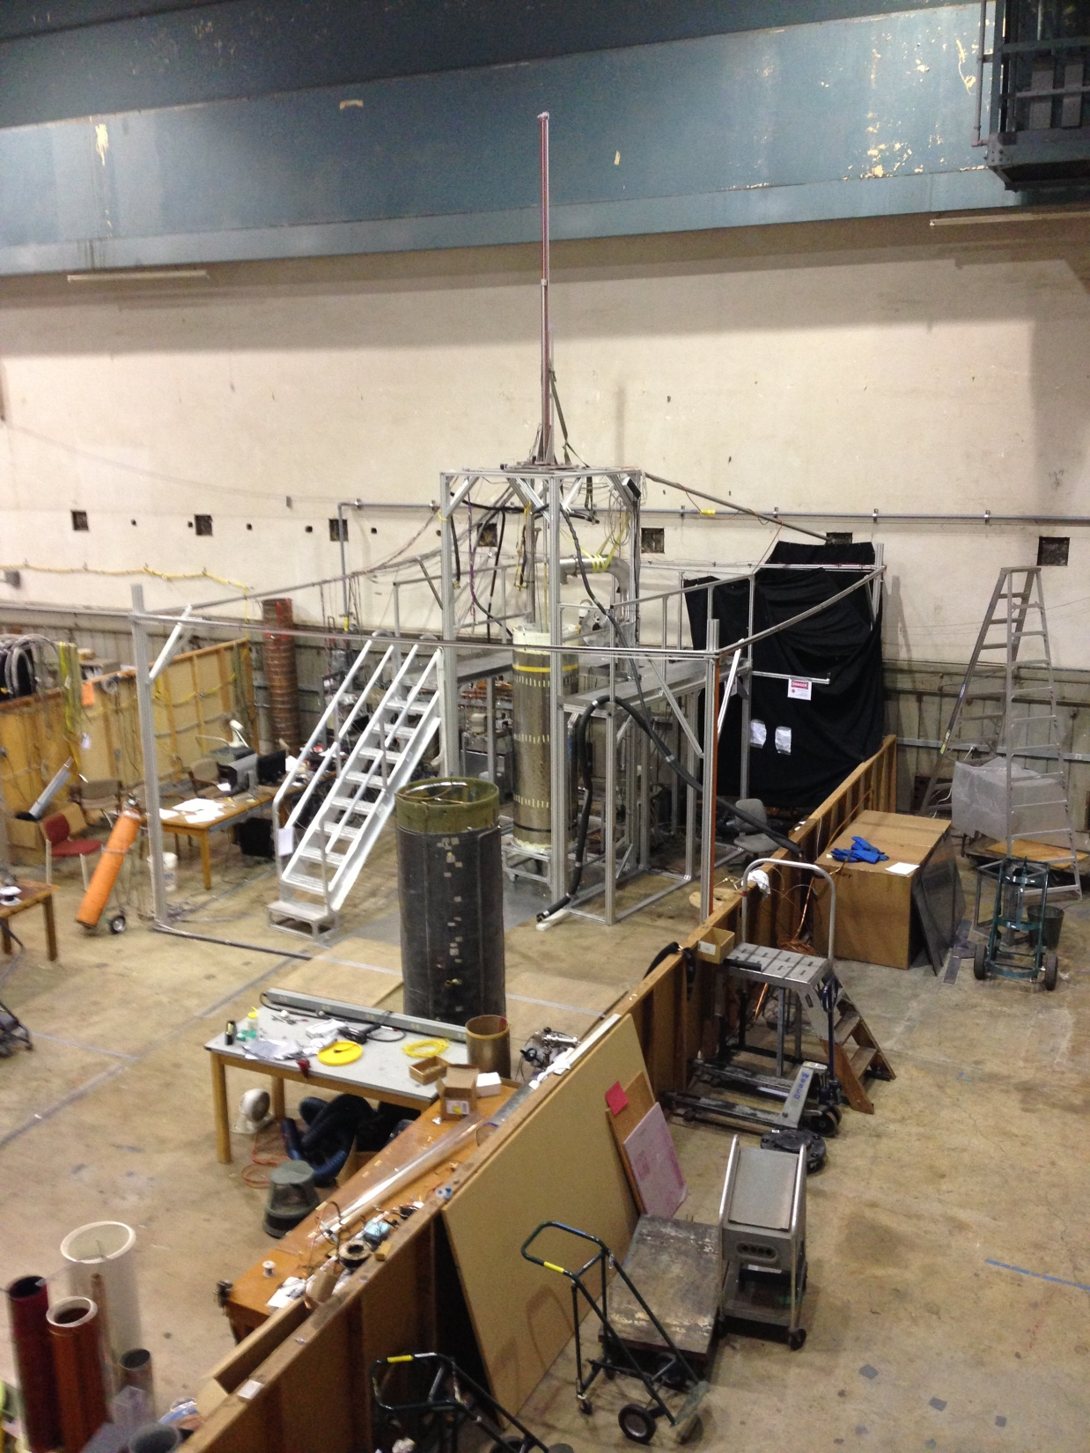
Caltech EDM lab (Synchrotron lab next to Lauritsen bldg)
Magnetometer
(fluxgate or atomic Cs + Laser)

Slide 52
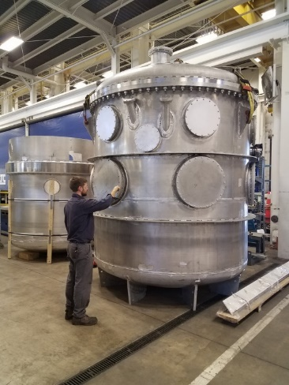
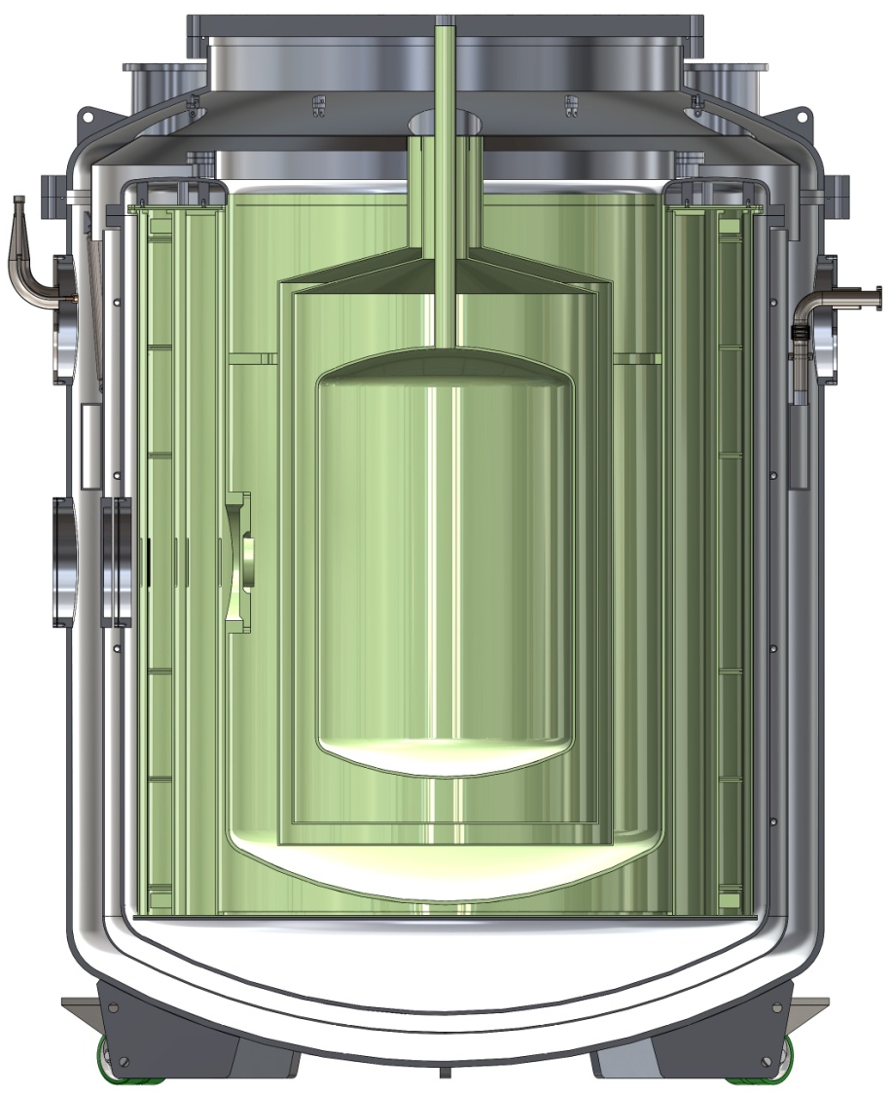
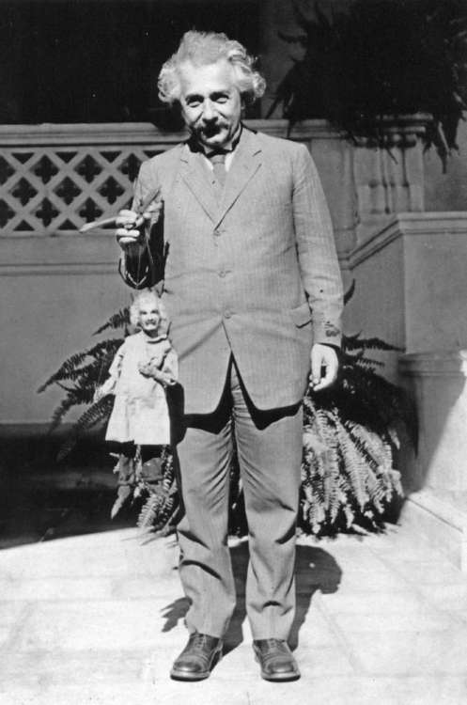
Magnetic System at CIT (to be Delivered to Synchrotron Lab in June)
4 K System for Superconducting Magnets
Spin Precession Magnet
Dressed Spin Magnets
Superconducting Magnetic Shield
Ready to test in neutron Beam in 2 yrs.

Slide 53
New n-EDM Sensitivity
Future neutron
EDM
1950
2000
2010

Slide 54
Summary
Physics reach of EDM measurements is enormous (even with results from the Large Hadron Collider)
New sources of CP violation likely in “Beyond-Standard-Model” Physics
A new neutron EDM experiment with two orders-of-magnitude improvement is underway
Significant discovery potential

Slide 55
Extra Slides …

Slide 56
Scattering Length
Repulsive Potential
Weak Attractive Potential
Strong Attractive Potential
Same !
Thus many different V₀ and r₀ can give same a
→ Fermi

Slide 57
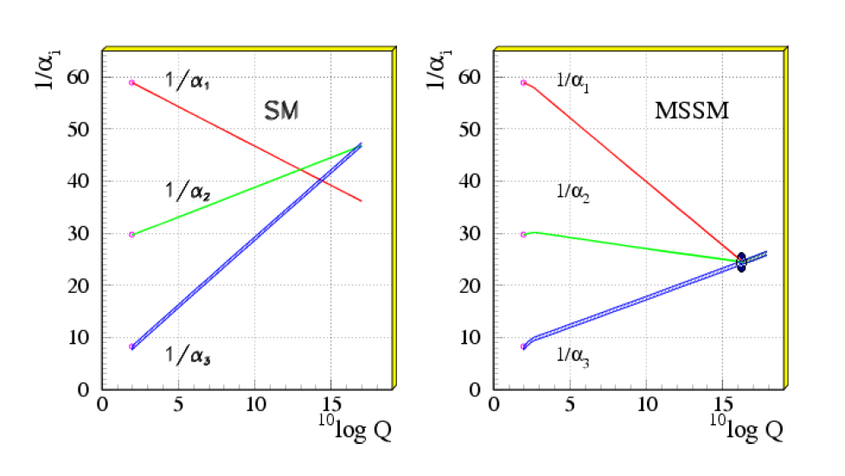
Why SUSY?
May be capable of “solving” gauge hierarchy
Why is the Planck mass = 10¹⁹ GeV so much larger than the electroweak mass (~ 10² GeV)
2. Can permit unification of strong & electroweak
couplings at the Planck mass (if M_{SUSY} ~ TeV)
3. Can have a SUSY particle as the cosmic Dark Matter (the Lightest SUSY Particle)

Slide 58
What’s in SUSY?
Each particle of the Standard Model has a partner in SUSY
Leptons and quarks have boson partners
Gauge particles and Higgs have fermion partners
Many new couplings possible
Minimal Supersymmetric Standard Model (MSSM)
Minimal set of new particles/couplings to produce a self-consistent model that is consistent with the standard model for energies < TeV

Slide 59
“Dressed Spins”
Can modulate the dressing field around a relative precession of zero.
Reducing effect of external B-fields
Measure scintillation light intensity asymmetry vs. direction of E-field
Challenging technical issues must be overcome
Uniformity of the RF field must be better than 0.1%
Eddy currents will heat conductors

Slide 60
Classical spin in AC B-field
y
Consider
x
B_{rf}
Solution:
z

Slide 61
Now consider two different particles with different γ_{i}

Slide 62
Systematic Controls in our experiment
Highly uniform E and B fields
Superconducting Magnetic Shield
Two cells with opposite E-field
Ability to vary influence of B₀ field
via “dressed spins”
Study dependence on |B|, B, B-gradients & ³He density
Control of central temperature
Can vary ³He diffusion which changes geometric phase effect on ³He

Slide 63
Summary of Experimental Components
Cold Neutron Beam
Cryogenic system (77K, 4K, .35K)
Polarized ³He System
Must inject, transport and remove ³He
With minimal polarization loss
With high efficiency
Magnets and Magnetic Shielding
Central Detector
HV, Light collection, SQUID monitors, …
Technically challenging!

Slide 64
Projected systematic errors
Error Source | Systematic error (e-cm) | Comments
Linear vxE (geometric phase) | < 2 x 10⁻²⁸ | Uniformity of B₀ field
Quadratic vxE | < 0.5 x 10⁻²⁸ | E-field reversal to <1%
Pseudomagnetic Field Effects | < 1 x 10⁻²⁸ | π/2 pulse, comparing 2 cells
Gravitational offset | < 0.2 x 10⁻²⁸ | With E-field dependent gradients < 0.3nG/cm
Heat from leakage currents | < 1.5 x 10⁻²⁸ | < 1 pA
vxE rotational n flow | < 1 x 10⁻²⁸ | E-field uniformity < 0.5%
E-field stability | < 1 x 10⁻²⁸ | ΔE/E < 0.1%
Miscellaneous | < 1 x 10⁻²⁸ | Other vxE, wall losses

Slide 65
e.g. - Geometric phase effect for ³He
L_{z}
L_{y}
G_{z}
G_{y}
Strong temperature dependence!

Slide 66

e.g. - Geometric phase effect for ³He
L_{z}
L_{y}
G_{z}
Strong temperature dependence!

Slide 67
Systematic Controls in SNS experiment
Highly uniform E and B fields
Superconducting Magnetic Shield
Two cells with opposite E-field
Ability to vary influence of B₀ field
via “dressed spins”
Study dependence on |B|, B, B-gradients & ³He density
Variation of ³He m.f.p. with LHe temperature
Can vary ³He diffusion which changes geometric phase effect on ³He
Can characterize B-gradients

